Slide 1

Proposal Defense
Team
19F-0113 Talha Ahmad
19F-0171 M. Talha Shehroze
19F-0254 Muhammad Farhan
Supervisor
Mr. Rizwan ul Haq

Slide 2
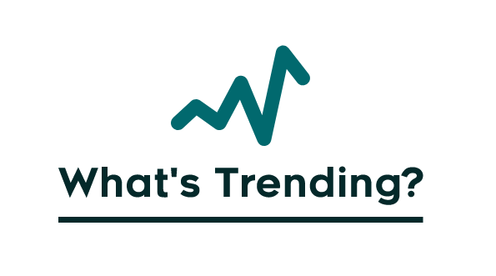
LOGO

Slide 3
Team/Company Name:
What’s trending
Supervisor(s):
Mr. Rizwan ul Haq
Co-Supervisor(s):
Mr. Sajid Anwer
Project Name/Title:
What’s trending (A Twitter Analysis Site)
What’s Trending?

Slide 4
Outline
Problem Statement
Project Introduction
Need for Project
Modules detail
Comparison
Architecture Diagram
Tools and Technologies
What’s Trending?

Slide 5

Problem Statement
“ Most of twitter trends are not authentic, generated by bot/fake accounts. These fake trends are main source of miss-information and results fake actions that are supported by millions of people causing unrest in society. “

Slide 6
Project introduction
Web-based application
Bot/fake Account Identification
Fake trend Recognition
Trending keywords Analysis
Twitter Account analysis
Sentiments analysis
Facilitate the user in making a better opinion

Slide 7
Need for project
There is no platform available for the public to check whether trending keyword is authentic or not, along with, bot account recognition, and sentimental of trends.

Slide 8
Modules
Sentiment Analysis
The system will extract the public sentiments positively or negatively using NLP.
Bot Account recognition
Identify whether the participating account was operated by a fake, bot, or authentic account.
What’s Trending?

Slide 9
Modules
Trend quality
Prediction of trend quality based on factors i.e., unique account participation, unique message, analyzing trend starter accounts, checking bot accounts participation, and some other factors by using AI, and ML techniques.
Trend/Account Analysis
Statistical analysis will predict the trend timeline, growth rate, growth region, activity graph, popular tweet, and popular retweet.

Slide 10
Related Project
Sentweet
(FYP Project: Muhammad Usman, Jahanzaib Yousaf - (FAST CFD, 2016) )
Foller - Provide rich insight on public profiles
Bot Sentinel - Classify twitter account

Slide 11
Comparison
What’s
Trending
Bot
Sentient
Foller
Sentweet
Features
Trend Check
Account Classification
Account Analysis
Bot Account Recognition
Sentiment Analysis
Trend analysis

Slide 12






Tools/Technologies

Slide 13
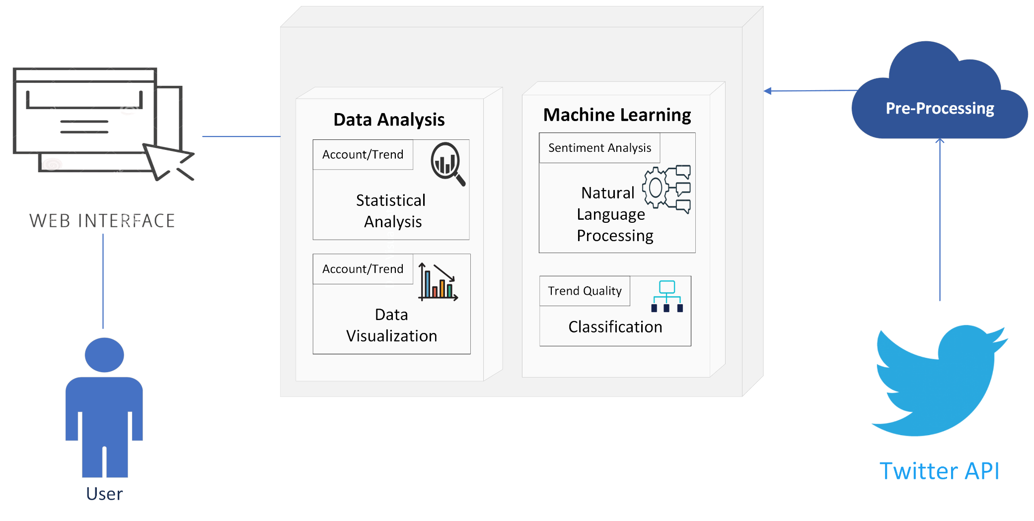
High Level System Diagram

